Slide 1
HUMAN RESOURCE PLANNING
Human Resource Planning (HRP) is a strategic process that organizations use to ensure they have the right number of people with the right skills at the right time. It involves forecasting future human resource needs and planning how to meet those needs.

Slide 2
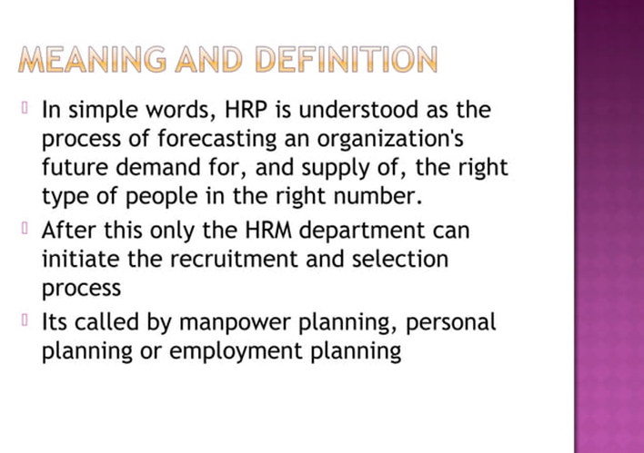

Slide 3
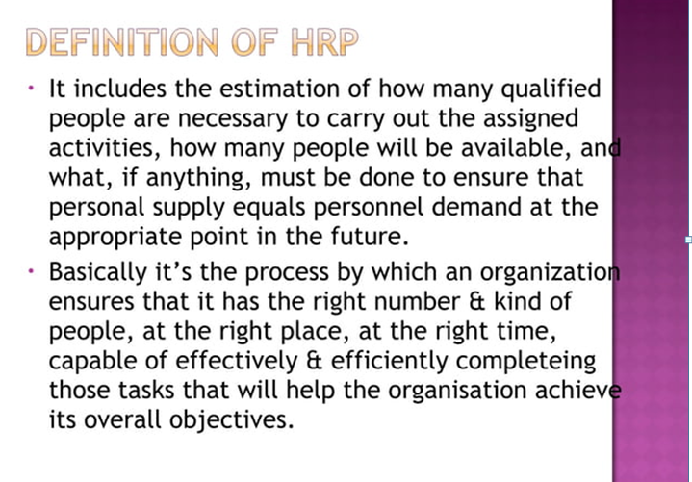

Slide 4
IMPORTANCE
Aligns Talent with Strategic Goals: HRP ensures that the organization has the right number of people with the right skills in the right places at the right times to achieve its strategic objectives. This alignment helps drive organizational success and competitiveness.
Prevents Talent Shortages and Surpluses: By forecasting future human resource needs, HRP helps prevent shortages or surpluses of staff. This is achieved through careful analysis of current workforce capabilities, anticipated changes in the business environment, and projected growth or downsizing.

Slide 5
Facilitates Recruitment and Retention:By understanding future needs, organizations can develop targeted recruitment campaigns and retention programs to keep valuable employees. Improves Employee Development and Succession Planning: HRP helps identify potential gaps in skills and competencies. This allows organizations to implement targeted training and development programs and to create succession plans for key positions, ensuring continuity and stability.
IMPORTANCE

Slide 6
Informs Decision Making:-This can include decisions about staffing, training, compensation, and organizational structure. Improves Financial Management: By forecasting labor costs and aligning them with the budget, HRP helps manage financial resources effectively. This can lead to cost savings and more efficient use of resources.

Slide 7
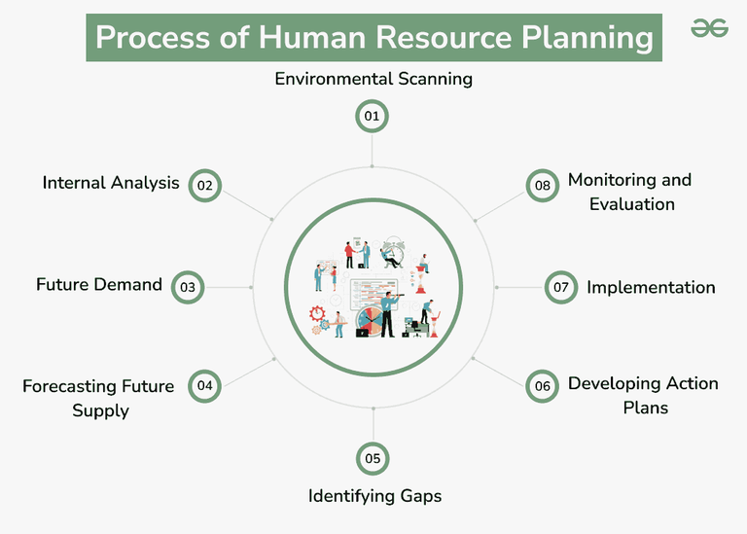

Slide 8
1. Environmental Scanning: Identify and analyze external factors that may affect the organisation’s human resource needs, such as economic trends, technological changes, and legislative requirements. 2. Internal Analysis: Evaluate the current workforce, including skills, competencies, and demographics. Understand the strengths and weaknesses of the existing workforce.
Process of Human Resource Planning (HRP)

Slide 9
3. Forecasting Future Demand: Project future demand for human resources based on organisational goals, growth plans, and changes in technology or markets.
4. Forecasting Future Supply: Assess the internal and external sources of human resources. Internal sources include current employees, while external sources may include recruitment strategies.
5. Identifying Gaps: Compare the forecasted demand and supply to identify potential gaps in the workforce. Identify potential areas of surplus or shortage.
6. Developing Action Plans: Devise strategies to address the identified gaps. This may involve recruitment, training, development, succession planning, or restructuring.

Slide 10
7. Implementation: Put the action plans into practice. This may include hiring new employees, providing training programs, or restructuring existing teams.
8. Monitoring and Evaluation: Continuously monitor the effectiveness of the human resource plans. Evaluate whether the organisation is achieving its goals and adjust the plans as necessary.

Slide 11
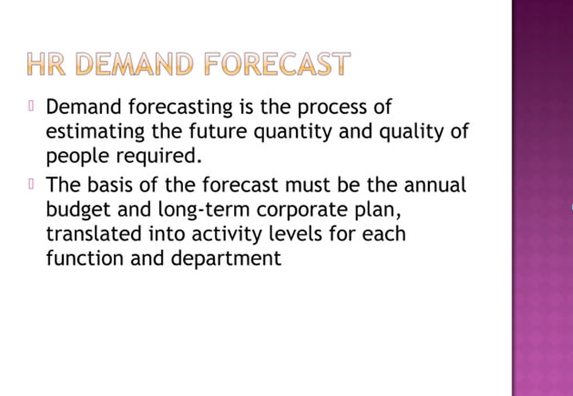

Slide 12
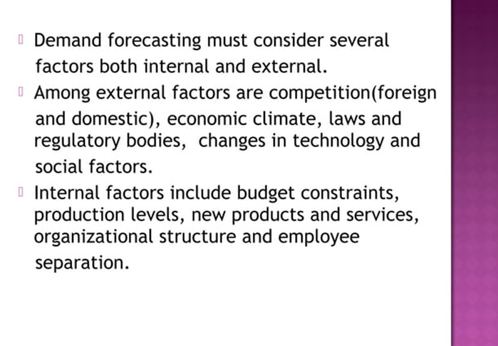

Slide 13
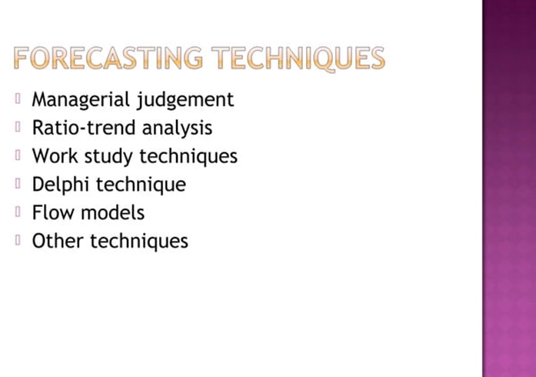

Slide 14
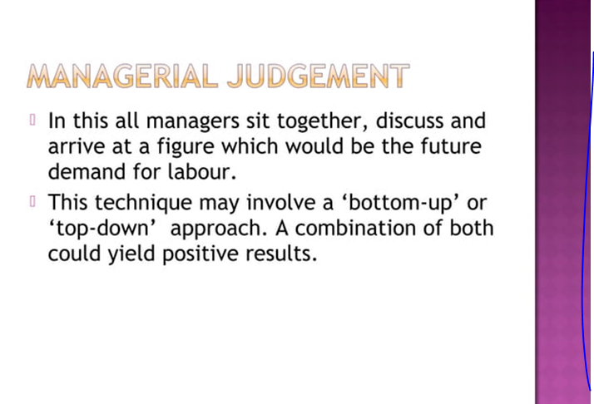

Slide 15
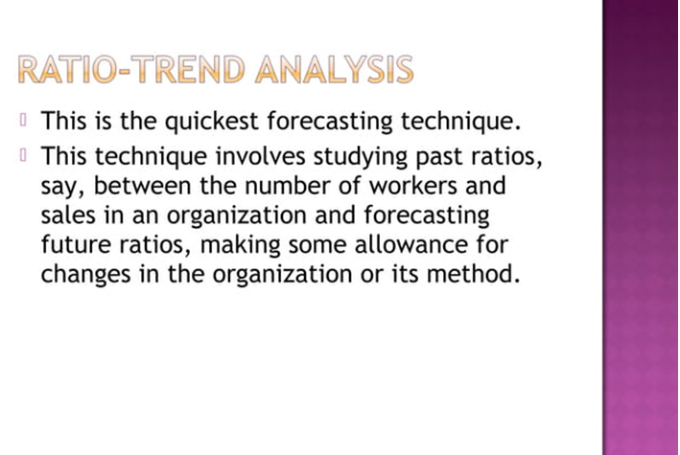

Slide 16
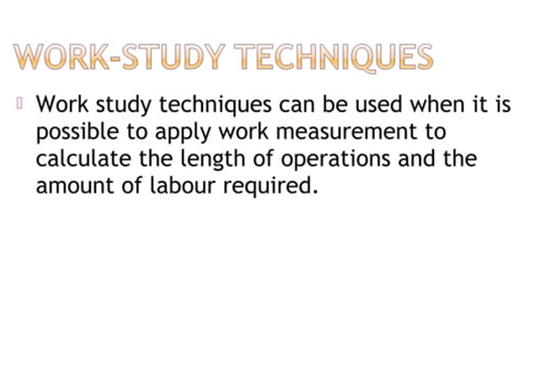

Slide 17
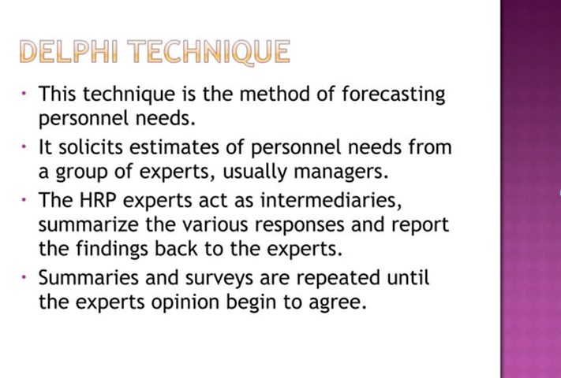

Slide 18
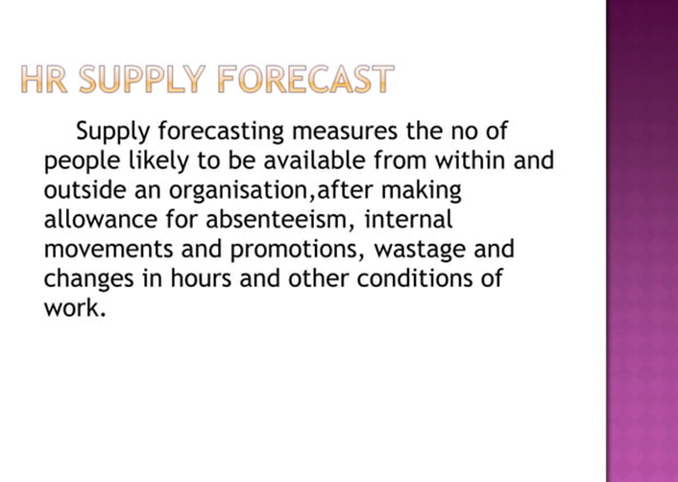

Slide 19
Internal Supply:
Current Employees: Using existing employees to fill vacancies or new roles. This includes promotions, transfers, and internal job postings.
Succession Planning: Preparing current employees to take on key positions in the future. This involves identifying high-potential employees and developing their skills for future roles.

Slide 20
External Supply:
Recruitment: Attracting new candidates from outside the organization through job postings, career fairs, and recruiting agencies.
Talent Pools: Engaging with potential candidates who may not be immediately available but could be interested in future opportunities. This includes building relationships through networking or maintaining a database of potential candidates.

Slide 21
Outsourcing:
Third-Party Providers: Contracting external companies to handle certain functions or tasks, such as payroll, recruitment, or even entire HR services.

Slide 22
Each of these types of supply can help organizations meet their workforce needs, depending on their strategic goals, budget, and the nature of the work required. Effective human resource planning involves balancing these sources to ensure a steady supply of talent and addressing any gaps that may arise.

